Slide 1
Heartland Expressway Construction Update
8/18/2020

Slide 2
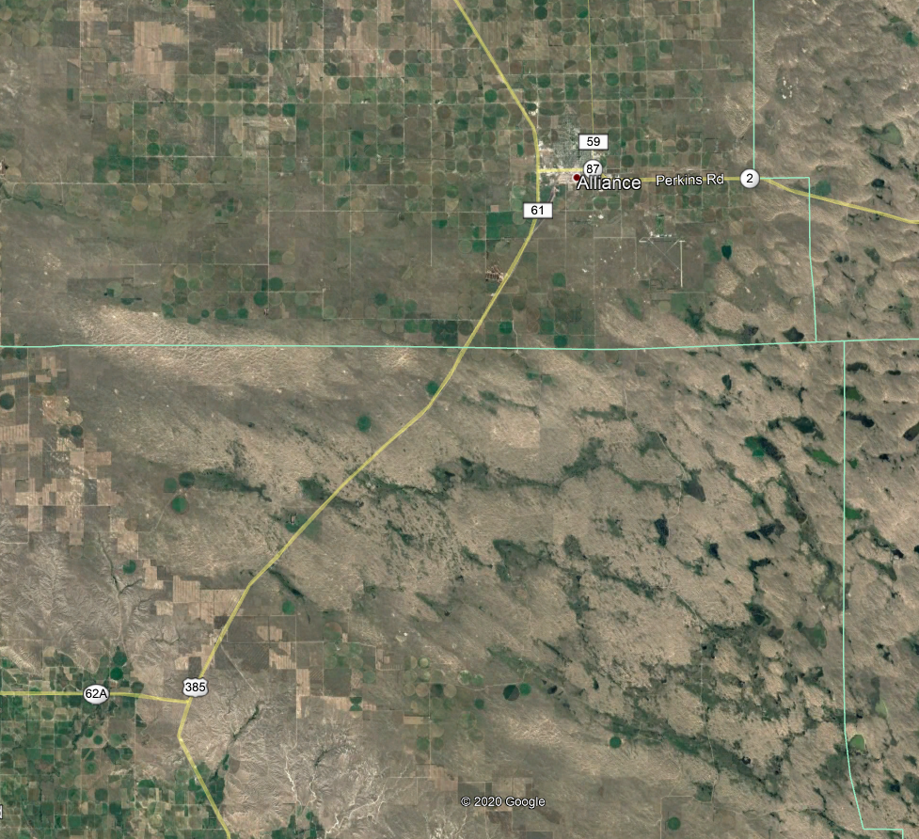
US-385 – “L-62A North”
Will connect existing expressway south of Alliance with L-62A
Scheduled for letting in November of 2020 with construction beginning in 2021
Once completed, 65 MPH Speed Limit will be raised to 70 MPH on 4-lane expressway section (from Alliance to L-62A)
Alliance South
L-62A North

Slide 3
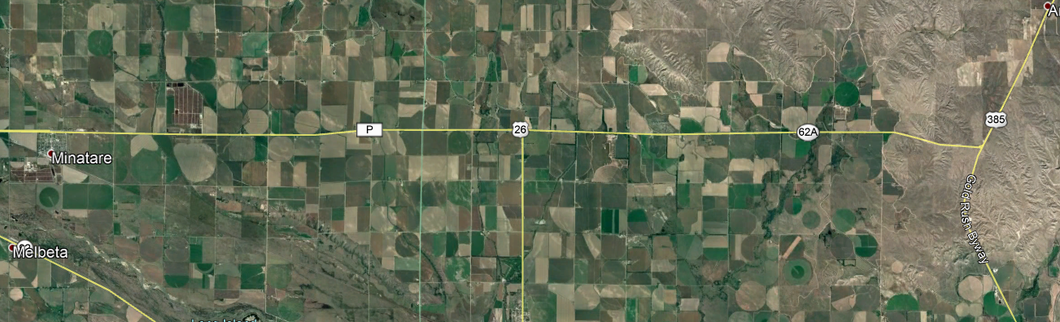
Minatare – US-385
Preliminary flight survey completed in fall of 2019
Same build strategy as US-385 south of Alliance (2+2)
Resurface existing lanes (2)
Build new concrete lanes (+2)
Design consultants being brought under contract
Design alignment alternatives
Conduct stakeholder meetings and open houses
Considerations for design process
Irrigation structures
Canals
Pivots
Homes
Businesses
Notes:
2+2 not to be confused with Super 2.
2+2 builds two additional lanes and resurfaces the existing two to create the new expressway.
Funding, and consequently timing is uncertain right now, so I don’t have a great estimate on timeframe for construction or even public meetings for this project.

